Slide 1
Digital Portfolio
G.karthika
STUDENT NAME:
REGISTER NO AND NMID: E87258EABCBA7F2B9CD4A6555D308ECF
DEPARTMENT: BSC. Computer science
COLLEGE: COLLEGE/ UNIVERSITY: LRG women's Arts and science College

Slide 2
PROJECT TITLE
Fundamental of web developement

Slide 3


AGENDA
Problem Statement
Project Overview
End Users
Tools and Technologies
Portfolio design and Layout
Features and Functionality
Results and Screenshots
Conclusion
Github Link
3/21/2024 Annual Review

Slide 4

PROBLEM STATEMENT
The fundamental problem statement in front-end web development centers on creating and maintaining a seamless, intuitive, and performant user experience across diverse devices and browsers while effectively translating design into functional, interactive interfaces.

Slide 5
Browser and Device Compatibility: Ensuring consistent rendering and functionality of web applications across various web browsers (Chrome, Firefox, Safari, Edge) and devices (desktops, tablets, mobile phones) with differing screen sizes, resolutions, and input methods.

Slide 6

PROJECT OVERVIEW
Front-end web development focuses on the user-facing part of a website or web application, often referred to as the client-side. Its primary goal is to create a visually appealing, interactive, and user-friendly interface that users can directly see and interact with.

Slide 7
Core Technologies: HTML (HyperText Markup Language): Provides the fundamental structure and content of a web page, defining elements like headings, paragraphs, images, and links. CSS (Cascading Style Sheets): Controls the visual presentation and layout of HTML elements, including colors, fonts, spacing, and responsiveness across different devices. JavaScript: Adds dynamic and interactive behavior to web pages, enabling features like animations, form validation, and communication with back-end servers

Slide 8

WHO ARE THE END USERS?
In the context of front-end web development, the end users are the individuals who directly interact with the website or web application. They are the audience for whom the front-end is built and designed. This includes anyone who: Visits a website: in a browser. Uses a web application: on a desktop or mobile device. Interacts with the visual elements: such as buttons, menus, forms, and content. Consumes the information: presented on the web page or application

Slide 9

TOOLS AND TECHNIQUES
HTML (HyperText Markup Language): The foundational language for structuring web content, defining elements like headings, paragraphs, images, and links. CSS (Cascading Style Sheets): Used for styling the appearance of web pages, controlling aspects like colors, fonts, layouts, and responsiveness across different devices. JavaScript: A programming language that adds interactivity, dynamic behavior, and complex logic to web pages, handling user interactions and data manipulation.

Slide 10
POTFOLIO DESIGN AND LAYOUT
Home page
About me
My profile
Email ID
Qualification
Skills
Contact me
10

Slide 11

Profile page:

Slide 12


About me:

Slide 13

My project:

Slide 14


My certificate:

Slide 15
FEATURES AND FUNCTIONALITY
HTML (HyperText Markup Language): Provides the structure and content of a web page, defining elements like headings, paragraphs, images, and links. CSS (Cascading Style Sheets): Controls the visual presentation of a web page, including layout, colors, fonts, and responsiveness across different devices. JavaScript: Adds interactivity and dynamic behavior to web pages, enabling features like animations, form validation, and data manipulation.

Slide 16

RESULTS AND SCREENSHOTS
3/21/2024 Annual Review
16

Slide 17
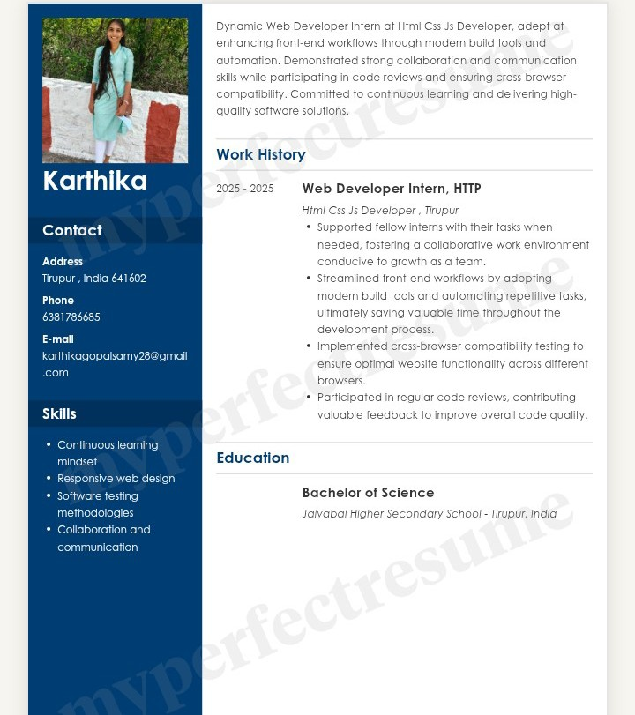

Slide 18


Slide 19
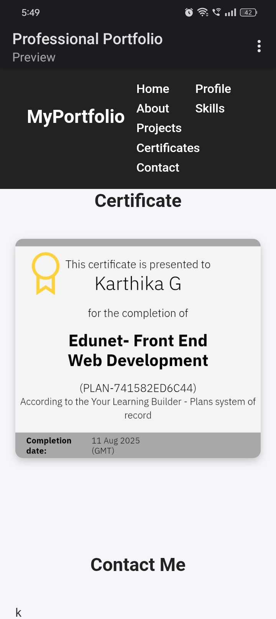

Slide 22


Slide 23
Fundamental front-end web development provides the essential skills and knowledge required to build the user-facing portion of websites and web applications. It forms the foundation for creating engaging and interactive digital experiences

Slide 25
CONCLUSION
Fundamental front-end web development provides the essential skills and knowledge required to build the user-facing portion of websites and web applications. It forms the foundation for creating engaging and interactive digital experiences
25

